Slide 1

White Box
Testing

Slide 2
White Box Testing
Definition
White box testing is a strategy in which testing is based on the internal paths, structure, and implementation of the software under test (SUT). Unlike its complement, black box testing, white box testing generally required programming skills.

Slide 3
White Box Testing
The general white box testing process is:
The SUT’s implementation is analyzed.
Paths through the SUT are identified.
Inputs are chosen to cause the SUT to execute selected paths. This is called path sensitization. Expected results for those inputs are determined.
The tests are run.
Actual outputs are compared with the expected outputs.
A determination is made as to the proper functioning of the SUT.

Slide 4
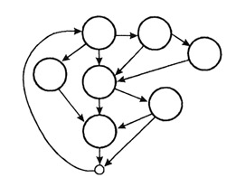
White Box Testing
Applicability
White box testing can be applied at all levels of system development-unit, integration, and system. Generally white box testing is equated with unit testing performed by developers. While this is correct, it is a narrow view of white box testing.
White box testing is more than code testing-it is path testing. Generally, the paths that are tested are within a module (unit testing). But we can apply the same techniques to test paths between modules within subsystems, between subsystems within system, and even between entire systems.

Slide 5
White Box Testing
Disadvantages
White box testing has four distinct disadvantages. First, the number of execution paths may be so large than they cannot all be tested. Attempting to test all execution paths through white box testing is generally as infeasible as testing all input data combinations through black box testing.

Slide 6
White Box Testing
Second, the test cases chosen may not detect data sensitivity errors. For example:
p=q/r;
may execute correctly except when r=0.
y=2*x // should read y=x²
will pass for test cases x=0, y=0 and x=2, y=4

Slide 7
White Box Testing
Third, white box testing assumes the control flow is correct (or very close to correct). Since the tests are based on the existing paths, nonexistent paths cannot be discovered through white box testing.
Fourth, the tester must have the programming skills to understand and evaluate the software under test. Unfortunately, many testers today do not have this background.

Slide 8
White Box Testing
Advantages
When using white box testing, the tester can be sure that every path through the software under test has been identified and tested.

Slide 9
Control
Flow
Testing

Slide 10
Control Flow Testing
This testing approach identifies the execution paths through a module of program code and then creates and executes test cases to cover those paths.
Path: A sequence of statement execution that begins at an entry and ends at an exit.
Unfortunately, in any reasonably interesting module, attempting exhaustive testing of all control flow paths has a number of significant drawbacks.

Slide 11
Control Flow Testing
The number of paths could be huge and thus untestable within a reasonable amount of time. Every decision doubles the number of paths and every loop multiplies the paths by the number of iterations through the loop. For example:
for (i=1; i<=1000; i++)
for (j=1; j<=1000; j++)
for (k=1; k<=1000; k++)
doSomethingWith(i,j,k);
executes doSomethingWith() one billion times (1000 x 1000 x 1000). Each unique path deserves to be tested.

Slide 12
Control Flow Testing
Paths called for in the specification may simply be missing from the module. Any testing approach based on implemented paths will never find paths that were not implemented.
if (a>0) doIsGreater();
if (a==0) dolsEqual();
// missing statement - if (a<0) dolsLess();

Slide 13
Control Flow Testing
Defects may exist in processing statements within the module even through the control flow itself is correct.
// actual (but incorrect) code
a=a+1;
// correct code
a=a-1;

Slide 14
Control Flow Testing
The module may execute correctly for almost all data values but fail for a few.
int blech (int a, int b) {
return a/b;
}
fails if b has the value 0 but executes correctly if b is not 0.
Even though control flow testing has a number of drawbacks, it is still a vital tool in the tester's toolbox.

Slide 15
Control Flow Testing
Technique
Control Flow Graphs
Control flow graphs are the foundation of control flow testing. These graphs document the module's control structure. Modules of code are converted to graphs, the paths through the graphs are analyzed, and test cases are created from that analysis. Control flow graphs consist of a number of elements:
Key Point Control flow graphs are the foundation of control flow testing.

Slide 16
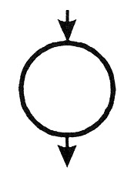
Control Flow Testing
Process Blocks
A process block is a sequence of program statements that execute sequentially from beginning to end. No entry into the block is permitted except at the beginning. No exit from the block is permitted except at the end. Once the block is initiated, every statement within it will be executed sequentially. Process blocks are represented in control flow graphs by a bubble with one entry and one exit.

Slide 17
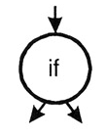
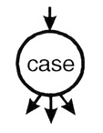
Control Flow Testing
Decision Point
A decision point is a point in the module at which the control flow can change. Most decision points are binary and are implemented by if-then-else statements. Multi-way decision points are implemented by case statements. They are represented by a bubble with one entry and multiple exits.

Slide 18

Control Flow Testing
Junction Point
A junction point is a point at which control flows join together.

Slide 19
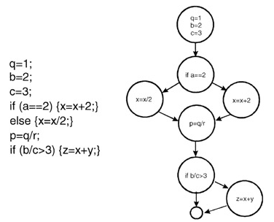
Control Flow Testing
The following code example is represented by its associated flow graph:
Figure: Flow graph equivalent of program code.

Slide 20
Control Flow Testing
Levels of Coverage
In control flow testing, different levels of test coverage are defined. By "coverage" we mean the percentage of the code that has been tested vs. that which is there to test. In control flow testing we define coverage at a number of different levels. (Note that these coverage levels are not presented in order. This is because, in some cases, it is easier to define a higher coverage level and then define a lower coverage level in terms of the higher.)

Slide 21
Control Flow Testing
Level 1
The lowest coverage level is "100% statement coverage" (sometimes the "100%" is dropped and is referred to as "statement coverage"). This means that every statement within the module is executed, under test, at least once. While this may seem like a reasonable goal, many defects may be missed with this level of coverage. Consider the following code snippet:
if (a>0) {x=x+1;}
if (b==3) {y=0;}

Slide 22
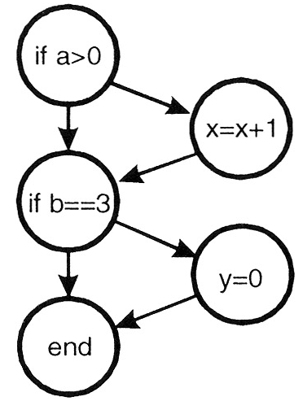
Control Flow Testing
This code can be represented in graphical form as:
Figure: Graphical representation of the two-line code snippet.

Slide 23
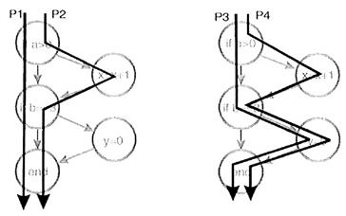
Control Flow Testing
These two lines of code implement four different paths of execution:
Figure: Four execution paths.

Slide 24
Control Flow Testing
While a single test case is sufficient to test every line of code in this module (for example, use a=6 and b=3 as input), it is apparent that this level of coverage will miss testing many paths. Thus, statement coverage, while a beginning, is generally not an acceptable level of testing.
Even though statement coverage is the lowest level of coverage, even that may be difficult to achieve in practice. Often modules have code that is executed only in exceptional circumstances-low memory, full disk, unreadable files, lost connections, etc. Testers may find it difficult or even impossible to simulate these circumstances and thus code that deals with these problems will remain untested.

Slide 25
Control Flow Testing
Level 0
Actually, there is a level of coverage below "100% statement coverage." That level is defined as "test whatever you test; let the users test the rest." Regarding this level of coverage, Boris Beizer wrote "testing less than this [100% statement coverage] for new software is unconscionable and should be criminalized. ... In case we haven't made ourself clear, ... untested code in a system is stupid, shortsighted, and irresponsible."

Slide 26
Control Flow Testing
Level 2
The next level of control flow coverage is "100% decision coverage." This is also called "branch coverage." At this level enough test cases are written so that each decision that has a TRUE and FALSE outcome is evaluated at least once. In the previous example this can be achieved with two test cases (a=-2, b=2 and a=4, b=3).

Slide 27
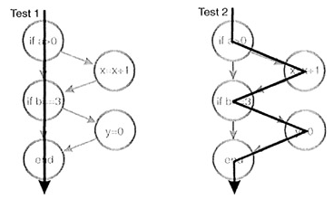
Control Flow Testing
Figure: Two test cases that yield 100% decision coverage.
Case statements with multiple exits would have tests for each exit. Note that decision coverage does not necessarily guarantee path coverage but it does guarantee statement coverage.

Slide 28
Control Flow Testing
Level 3
Not all conditional statements are as simple as the ones previously shown. Consider these more complicated statements:
if (a>0 && c==1) {x=x+1;}
if (b==3 || d<0) {y=0;}
To be TRUE, the first statement requires a greater than 0 and c equal 1. The second requires b equal 3 or d less than 0.

Slide 29
Control Flow Testing
In the first statement if the value of a were set to 0 for testing purposes then the c==1 part of the condition would not be tested. (In most programming languages the second expression would not even be evaluated.) The next level of control flow coverage is "100% condition coverage." At this level enough test cases are written so that each condition that has a TRUE and FALSE outcome that makes up a decision is evaluated at least once. This level of coverage can be achieved with two test cases (a>0, c=1, b=3, d<0 and a≤0, c≠1, b≠3, d≥0). Condition coverage is usually better than decision coverage because every individual condition is tested at least once while decision coverage can be achieved without testing every condition.

Slide 30
Control Flow Testing
Level 4
Consider this situation:
if(x&&y) {conditionedStatement;}
// note: && indicates logical AND
We can achieve condition coverage with two test cases (x=TRUE, y=FALSE and x=FALSE, y=TRUE) but note that with these choices of data values the conditionedStatement will never be executed. Given the possible combination of conditions such as these, to be more complete "100% decision/condition" coverage can be selected. At this level test cases are created for every condition and every decision.

Slide 31
Control Flow Testing
Level 5
To be even more thorough, consider how the programming language compiler actually evaluates the multiple conditions in a decision. Use that knowledge to create test cases yielding "100% multiple condition coverage."
if (a>0 && c==1) {x=x+1;}
if (b==3 || d<0) {y=0;}
// note: || means logical OR

Slide 32
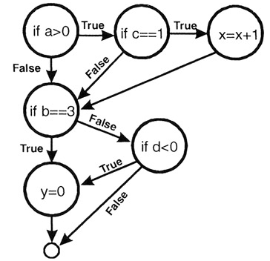
Control Flow Testing
will be evaluated as:
Figure: Compiler evaluation of complex conditions.

Slide 33
Control Flow Testing
This level of coverage can be achieved with four test cases:
a>0, c=1, b=3, d<0
a≤0, c=1, b=3, d≥0
a>0, c≠1, b≠3, d<0
a≤0, c≠1, b≠3, d≥0
Achieving 100% multiple condition coverage also achieves decision coverage, condition coverage, and decision/condition coverage. Note that multiple condition coverage does not guarantee path coverage.

Slide 34
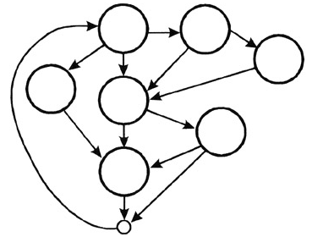
Control Flow Testing
Level 7
Finally we reach the highest level, which is "100% path coverage." For code modules without loops the number of paths is generally small enough that a test case can actually be constructed for each path. For modules with loops, the number of paths can be enormous and thus pose an intractable testing problem.
Figure: An interesting flow diagram with many, many paths.

Slide 35
Control Flow Testing
Level 6
When a module has loops in the code paths such that the number of paths is infinite, a significant but meaningful reduction can be made by limiting loop execution to a small number of cases. The first case is to execute the loop zero times; the second is to execute the loop one time, the third is to execute the loop n times where n is a small number representing a typical loop value; the fourth is to execute the loop its maximum number of times m. In addition you might try m-1 and m+1.
Before beginning control flow testing, an appropriate level of coverage should be chosen.

